Slide 1
INFO 5100 : Application Engineering and Development
Lab 1 : Class + Object + Relationships

Slide 2
Objective
Demonstrate how to create a java/swing application
How to define java classes
How to create and populate java objects
How to pass data between from the Jframe to JPanels

Slide 3
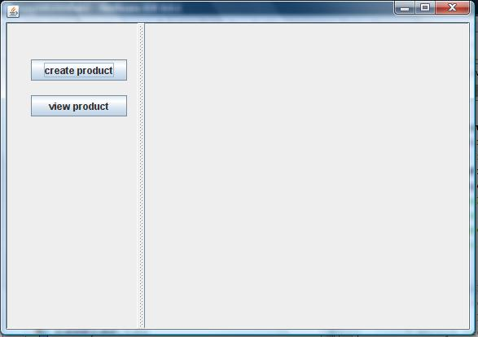
Output Application 1

Slide 4
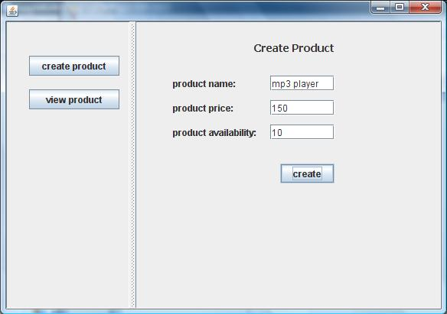
Output Step 1
1
2

Slide 5
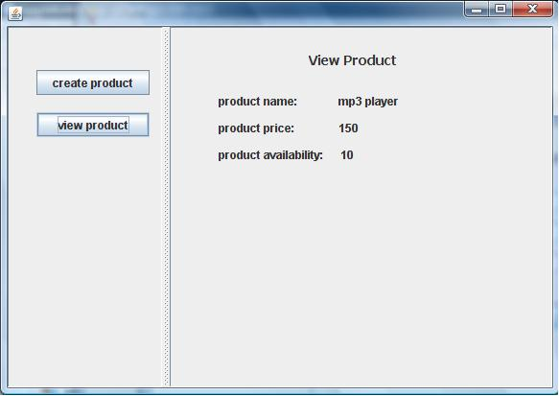
Output Step 2
1
2

Slide 6
How to create and move data in and out of objects?
Data
-Name
-Price
-Availability
Product
Object
Display

Slide 7
The approach:
class Product {
<attributes>
:
<methods>
}
Product Class
Use the java new operator to instantiate the class
new product()
Product
Object
Data
-Name
-Price
-Availability
Display

Slide 8
Java Reference variables
When we create things we need to keep track of them. If not we would never be able to find them.
A reference variable has a name. We use the name to find the variable and then look inside to find information about where the object is
Memory space (a place holder) for keeping track of an object but it is not an object in itself
An object has a numeric address of where it can be found
We save the address inside the reference variable as a way to get hold of the object
p1
If object address: 0298289
0298289
Dell Laptop 2021

Slide 9
Java Reference variables
//example class definition Public class Product {
String name;
Public Product(){}
:
:
}
//Example main program:
public class Main {
public static void main(String[] args) {
// TODO code application logic here
Product p1 = new Product();
p1.setName("MacBook ...");
Product p2 = new Product();
p2.setName("Dell ...");
Product p3 = new Product();
p3.setName("Toshiba ...");
}
}
p1
MackBook 1101
Dell Laptop 2021
Toshiba Tecra 1100
p1 = new product()
p2
p2 = new product()
Product Class
p3 = new product()
p3

Slide 10
Instantiation: From classes to objects
p1
MackBook 1101
Dell Laptop 2021
Toshiba Tecra 1100
p1 = new Product()
p2
p1 = new product()
Product Class
p1 = new product()
p3

Slide 11
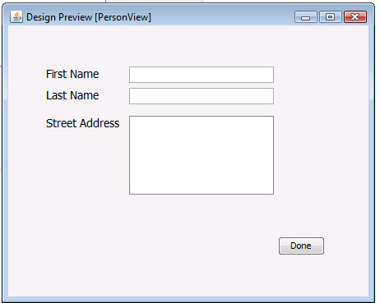
Connecting components to UI
Person
FirstName
LastName
Address
Person is an object that is an instance of class Person. Must be created using the new operator

Slide 12
Data attributes are accessed through their interfaces
class Person {
Person
lastName: String
firstName: String
address: String
FirstName
LastName
Address
getLastName();
getFirstName();
getFullName();
getAddress();
setLastName()
setFirstName()
setAddress();
}

Slide 13
Form fields correspond to data attributes
class Person {
lastName: String
firstName: String
address: String
Person
getLastName();
getFirstName();
getFullName();
getAddress();
setLastName()
setFirstName()
setAddress();
}

Slide 14
Form fields have names
class Person {
lastName: String
firstName: String
address: String
Person
Field name is FirstNameTextField
getLastName();
getFirstName();
getFullName();
getAddress();
setLastName()
setFirstName()
setAddress();
}

Slide 15
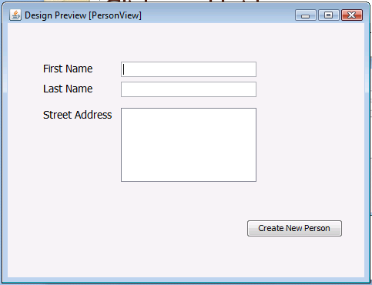
2
class Person {
Person person = new Person();
lastName: String
firstName: String
address: String
Person
getLastName();
getFirstName();
getFullName();
getAddress();
setLastName()
setFirstName()
setAddress();
}
1
FirstName
LastName
Address
Person p = new Person();
String fn = firstnameTextField.getText();
p.setFirstName(fn);
….
person

Slide 16
class Person {
3
lastName: String
firstName: String
address: String
Person
String fn = FirstNameTextField.getText();
getLastName();
getFirstName();
getFullName();
getAddress();
setLastName()
setFirstName()
setAddress();
}
FirstName
LastName
Address
Person p = new Person();
String fn = firstnameTextField.getText();
p.setFirstName(fn);
….
person

Slide 17
class Person {
3
lastName: String
firstName: String
address: String
Person
String fn = FirstNameTextField.getText();
getLastName();
getFirstName();
getFullName();
getAddress();
setLastName()
setFirstName()
setAddress();
}
person.setFirstName(fn);
4
FirstName
LastName
Address
Person p = new Person();
String fn = firstnameTextField.getText();
….
person

Slide 18
class Person {
lastName: String
firstName: String
address: String
Person
getLastName();
getFirstName();
getFullName();
getAddress();
setLastName()
setFirstName()
setAddress();
}
FirstName
LastName
Address
Person p = new Person();
String fn = firstnameTextField.getText();
p.setFirstName(fn);
….

Slide 19
Output Application 1

Slide 20
Output Step 1
1
2

Slide 21
Output Step 2
1
2

Slide 22
Swing application structure
JFrame
JButton
JPanel
JSplitPane

Slide 23
One UI and two tasks (create/View)
Jframe (MainJFrame)
Jpanel for create a product
Jpanel for displaying a product

Slide 24
Pass the product object
Jframe (MainJFrame)
Product Object
Create Product JPanel
Product Object
Input fields
NameTextField
PriceTextField
Customer

Slide 25
Jframe (MainJFrame)
Product Object
Create Product JPanel
Input fields
NameTextField
PriceTextField
Customer
name
price

Slide 26
Putting the display panels together
Jframe (MainJFrame)
Product Object
Display Product JPanel
Product Object
Output fields
NameTextField
PriceTextField

Slide 27
Putting the display panels together
Jframe (MainJFrame)
Product Object
Display Product JPanel
Output fields
NameTextField
PriceTextField
name
price

Slide 28
Procedure
Create a new project
Define Business Package
Create product class
Define UserInterface Package
Define JFrame
Define Jpanels (Create and View)
Button listeners

Slide 29
Create Product Class under the business package
Product
name
price
availability
description
Attribute
Method

Slide 30
Product Class
public class Product {
private String name;
private String price;
:
public String getName() // retrieve data
{ return name; }
:
public void setName(String n) // keep data
{ name = n; }
:
}

Slide 31
Define MainJFrame Class under the userinterface package
Create a global variable of product for this class
class MainJFrame {
public MainJFrame() {
initComponents();
}
}
Constructor
Method that creates visual components

Slide 32
Define MainJFrame Class under the userinterface package
Create a global variable of product for this class
class MainJFrame {
private Product product; // Global Variable
public MainJFrame() {
initComponents();
product = new Product(); // Instantiate the object (global variable)
}
}

Slide 33
Define CreaCreateProductJPanel class under the userinterface package
class CreateProductJPanel() {
CreateProductJPanel() {
initComponents();
}
<other stuff>
}
Constructor
Method that creates visual components

Slide 34
Define CreaCreateProductJPanel class under the userinterface package
class CreateProductJPanel() {
CreateProductJPanel(Product p) {
initComponents();
product = p;
}
<other stuff>
}
Constructor

Slide 35
Create Product
In the constructor of CreateProductJPanel class
public CreateProductJPanel(Product p) {
initComponents();
}

Slide 36
View Product
In the constructor of ViewProductJPanel class
public ViewProductJPanel(Product p) {
initComponents();
this.product = p;
nameTextField.setText(product.getName());
priceTextField.setText(product.getPrice());
}

Slide 37
Button Events
When Create or View buttons are clicked on the left side, the following actions should be performed respectively.
Create Button
CreateProductJPanel j = new CreateProductJPanel(product);
jSplitPane1.setRightComponent(j);
View Button
ViewProductJPanel v = new ViewProductJPanel(product);
jSplitPane1.setRightComponent(v);

Slide 38
Create Button
When “create button” is clicked, following actions should be performed in the action perform method of the button
p.setName(nameField.getText()); //
p.setPrice(priceField.getText());
p.setAvailability(availabilityField.getText());

Slide 39
View Button
When “create button” is clicked, following actions should be performed in the action perform method of the button
nameTextField.setText(p.getName());
priceTextField.setText(product.getPrice());

Slide 40
Programming relationships
Show how to implement relationships between classes
Show how java works to connect and access objects
Show how to traverse relationships

Slide 41
The Business Model
Person
First name,
Last name,
Social security number
DOB
Address Line 1,
Address Line 2,
City
Country
Zipcode
Etc

Slide 42
Example: One person multiple addresses
Joe,
Smith,
290-29-2974
2/2/1986
360 Huntington Ave
Snell Engineering
Boston
MA
USA
02115
Etc….
Joe,
Smith,
290-29-2974
2/2/1986
100 Main Street,
Natick
MA
USA
01760
Etc….
Joe,
Smith,
290-29-2974
2/2/1986
201 Best street
Cool-town
Shanghai
China
Etc …..
Work Local home

Slide 43
Multiple addresses means duplication of information and potential for errors
Joe,
Smith,
290-29-2974
2/21/1990
360 Huntington Ave
Snell Engineering
Boston
MA
USA
02115
Etc….
Joe,
Smith,
200-29-2974
2/2/1986
100 Main Street,
Natick
MA
01760
USA
Etc….
Joe,
Summer,
290-29-2974
2/2/1986
201 Best Street
Cool-town
Shanghai
China
Etc …..
Work Local home

Slide 44
What if we split the info into:
First name,
Last name,
Social security number
DOB
Address Line 1,
Address Line 2,
City
Country
Zipcode

Slide 45
What if we split the info into:
First name,
Last name,
Social security number
DOB
Address
Address Line 1,
Address Line 2,
City
Country
Zipcode
Personal information
Address specific

Slide 46
What if we split the info into:
First name,
Last name,
Social security number
DOB
Address
Address Line 1,
Address Line 2,
City
Country
Zipcode
Person
Address

Slide 47
One person object linked to three address objects each keeping track of one address
Address I
Address 2
Address 3
Joe the
Person

Slide 48
A reference variable is needed in the person class to keep track of the address object
Person
address
Address
person
From the person perspective, we must add
An address attribute which will serve as a reference variable to the address object
getAddress method to retrieve the address object
setAddress method to store the address object as part of the person

Slide 49
But how do we differentiate different kinds of addresses from each other such as work, home,…?
Person
Address
Answer: we can’t with this kind of relationship unless we add an address type attribute to the address class

Slide 50
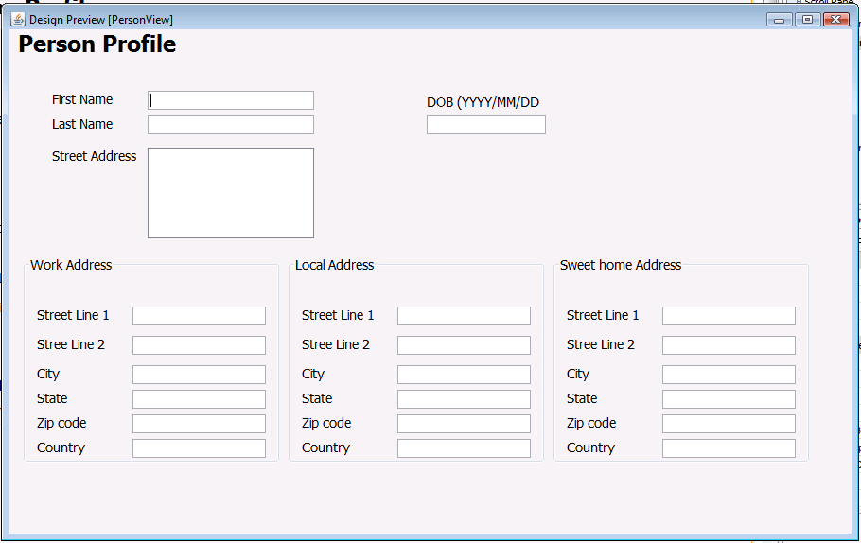
View Person Profile Screen
home address
Person
Work address
Address
local address

Slide 51
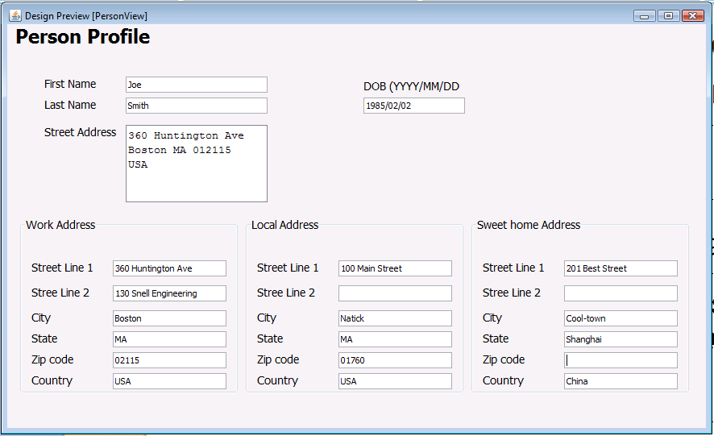

Slide 52
Matching the model to the user interface
Person
home address
Person
Work address
Address
Address
Address
Address
local address

Slide 53
home address
Person
Work address
Address

Slide 54
Changes are localized at the single address – person info remains fixed
home address
Person
Work address
Address
Display
local address
Home address
Work address
Local address
Update object from user

Slide 55
home address
Person
Work address
Address
local address

Slide 56
Class Person {
String lastName;
String firstName;
Address workaddress;
Address homeaddress;
Address localaddress;
public Address getWorkAddress(){
Return workaddress;
}
Public void setWorkAddress(Address addressparam){
Workaddress = addressparam;
}
:::
}

Slide 57
Class Person {
String lastName;
String firstName;
Address workaddress;
Address homeaddress;
Address localaddress;
public Address getWorkAddress(){
Return workaddress;
}
Public void setWorkAddress(Address addressparam){
Workaddress = addressparam;
}
:::
}
3 reference variables for keeping track of the 3 addressess

Slide 58
Implementation of the class Person
Class Person {
String lastName;
String firstName;
Address workaddress;
Address homeaddress;
Address localaddress;
public Address getWorkAddress(){
Return workaddress;
}
Public void setWorkAddress(Address addressparam){
Workaddress = addressparam;
}
:::
}
The reference variables hold addresses only. The must be declared of type Address

Slide 59
Class Person {
String lastName;
String firstName;
Address workaddress;
Address homeaddress;
Address localaddress;
public Address getWorkAddress(){
Return workaddress;
}
Public void setWorkAddress(Address addressparam){
Workaddress = addressparam;
}
:::
}

Slide 60
Implementation of the class Person
Class Person {
String lastName;
String firstName;
Address workaddress;
Address homeaddress;
Address localaddress;
public Address getWorkAddress(){
return workaddress;
}
Public void setWorkAddress(Address addressparam){
Workaddress = addressparam;
}
:::
}
The get method returns the workaddress object. The return value must be of type Address

Slide 61
Implementation of the class Person
Class Person {
String lastName;
String firstName;
Address workaddress;
Address homeaddress;
Address localaddress;
public Address getWorkAddress(){
Return workaddress;
}
Public void setWorkAddress(Address addressparam){
workaddress = addressparam;
}
:::
}
The set method returns nothing (void). It takes an address object as an input parameter and saves it in the workaddress attribute. As a result the person would be linked to an address object as the work address.

Slide 62
Implementation of the class Person
Person person = new Person();
person.setFirstName(“Joe”);
person.setLastName(“Smith”);
address address = new Address();
address.setAddressLine1(“360 Huntington Ave”);
person.setWorkAddress(address); //save address object as a work address
address = new Address(); // create new address object using the same ref variable
address.setAddressLine1(“100 Main Street”); //insert address info
person.setLocalAddress(address);
address = new Address();
address.setAddressLine1(“201 Best Street”);
Person.setHomeAddress(address);
//save address object as a local address

Slide 63
Consider the following form
Define a jframe with a jpanel similar to

Slide 64
Exercise 1
Define a project with a main class.
Define the classes as described
In the main method do the following:
Create a person object and three address objects. Initialize the objects with sample data.
Use the system.printlin function to print all your data in a format like the following:
Person
First name : Joe
Last name: Smith
Work Address
Address Line 1: 360 Huntington Ave.
Etc….

Slide 65
Exercise 2
Define a project with a jframe
In the constructor for the jframe initialize a person object and three address like before.
Pass the person object to a jpanel to display the person info as showing the form defined earlier.
In the constructor for the jpanel display the person and 3 addresses to the jpanel form.

